Slide 1
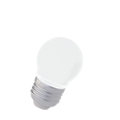
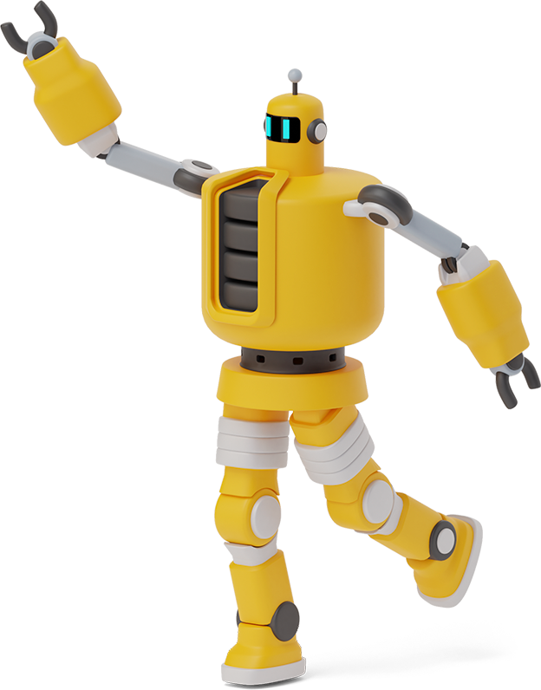
PRO-C102: AUTOMATION

Slide 2
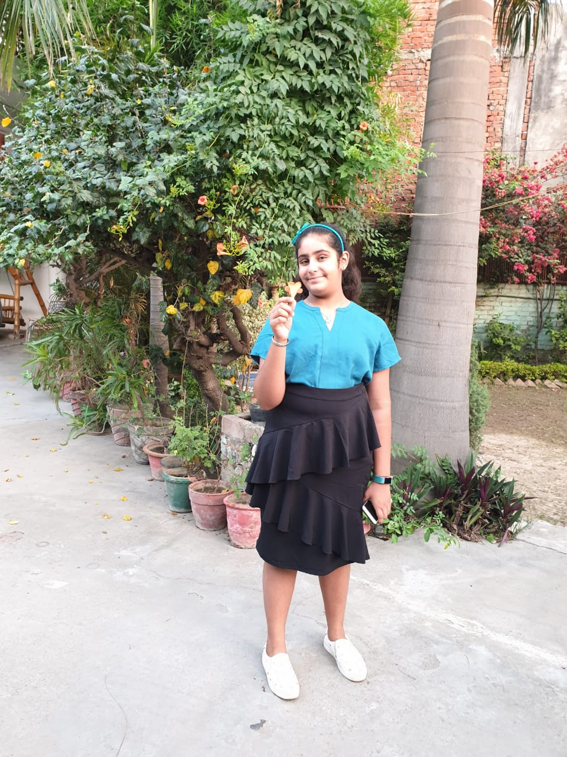
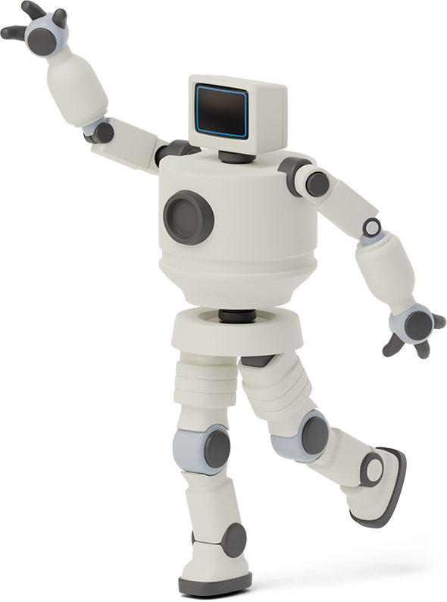

Hello!
I am Shreshtha Chaudhary
I am a professional coder.I am here because I have to complete my homework and then submit it to Miss Aishwarya Mam.

Slide 3

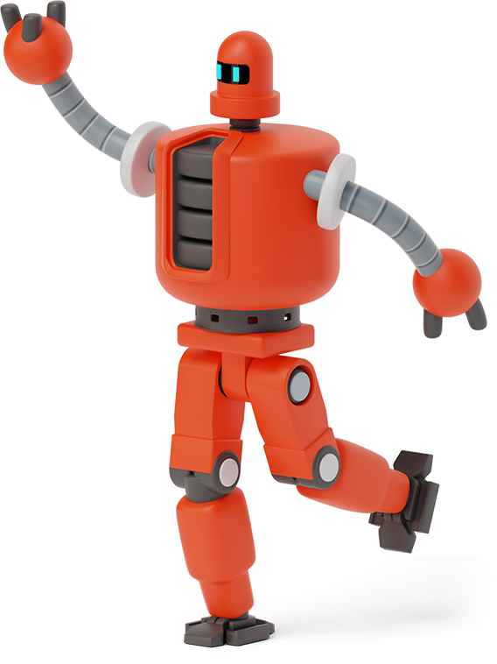
Automate: Making my bed and switching on lights in morning
1
Let’s start with the process

Slide 4
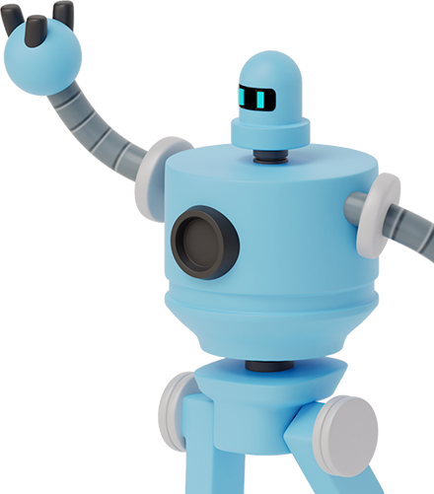
“Any fool can write code that a computer can understand. Good programmers write code that humans can understand. — Martin Fowler”.

Slide 5

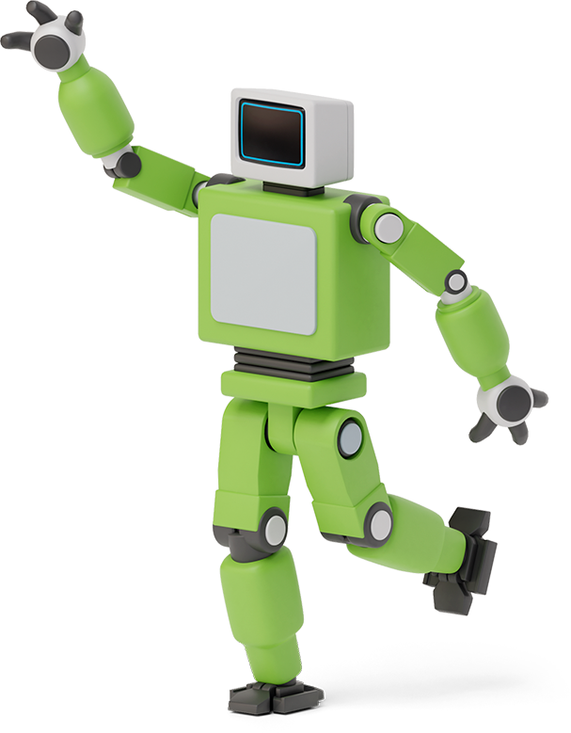

Process of me doing this by myself(Boring)
My alarm sets off at around 8AM.
Unfortunately,I have to sprang up off the bed and disturb my sweet sleep.
After getting up , I have to go all around my bed to reach just one switch of light to brighten my room.(Tiring)

Slide 6
Process of me doing this by myself(Boring)
After switching on the lights, I go to freshen up and wash my face.(while doing this, I hurt myself around 2 to 3 times everyday)
After freshing up, I go to my room and sit comfortably while thinking what to do today and which books I have to keep for school today.

Slide 7
Process of me doing this by myself(Boring)
After that I getting scolding from mom to make my bed and then I have to get up and go to my room.
I make my bed in about 10 to 15 min doing it slowly and leisurely as I can.
After that my bed is ready and I am ready to start my day after a boring work.

Slide 8

Big concept
Now the ways I hope it can be in : Automated ways:

Slide 9

Process completed automatically
First of all an alarm, I want an alarm that rings everyday at 8AM with my favourite songs(as I love hearing songs after getting up in the morning). Alarm keeps ringing and when I say good morning to it, it should as me a puzzle like a mathematical puzzle to check whether I am up or not.
Then after getting up, I want an application that should be attached with my lights by Bluetooth not with Wifi as if wifi is not there it will not work. The application should have 4 functions which are:
It should have a switch on and switch off option.
It should have a voice recognition system for switch.
It should have a system so I can set the lightings to be on at a particular time in the morning and then to be off at night
It should increase and decrease the brightness according to day and night

Slide 10
Process completed automatically
After lightings , I freshen up and after that I want an application to remind me to make my bed thus saving me from mom scolding and that app should set a timer for me to prepare the bed without sitting or moving here and there and when I am done it should give me some reward like amazon pay balance or discounts.
At last, I would love these rewards and will never forget to make my bed and mom will think that I have changed but in real I am doing it so I can shop.

Slide 11

Want big impact?
Use big image and creativity.

Slide 12
Use diagrams to explain your ideas
Application
Lightings
Bed making
ON/OFF with voice recoginition
Timer with brightness adjusting
Reminder
Timer and most important a reward

Slide 13
THANK YOU I HOPE YOU LIKE MY PRESENTATION

